Slide 1
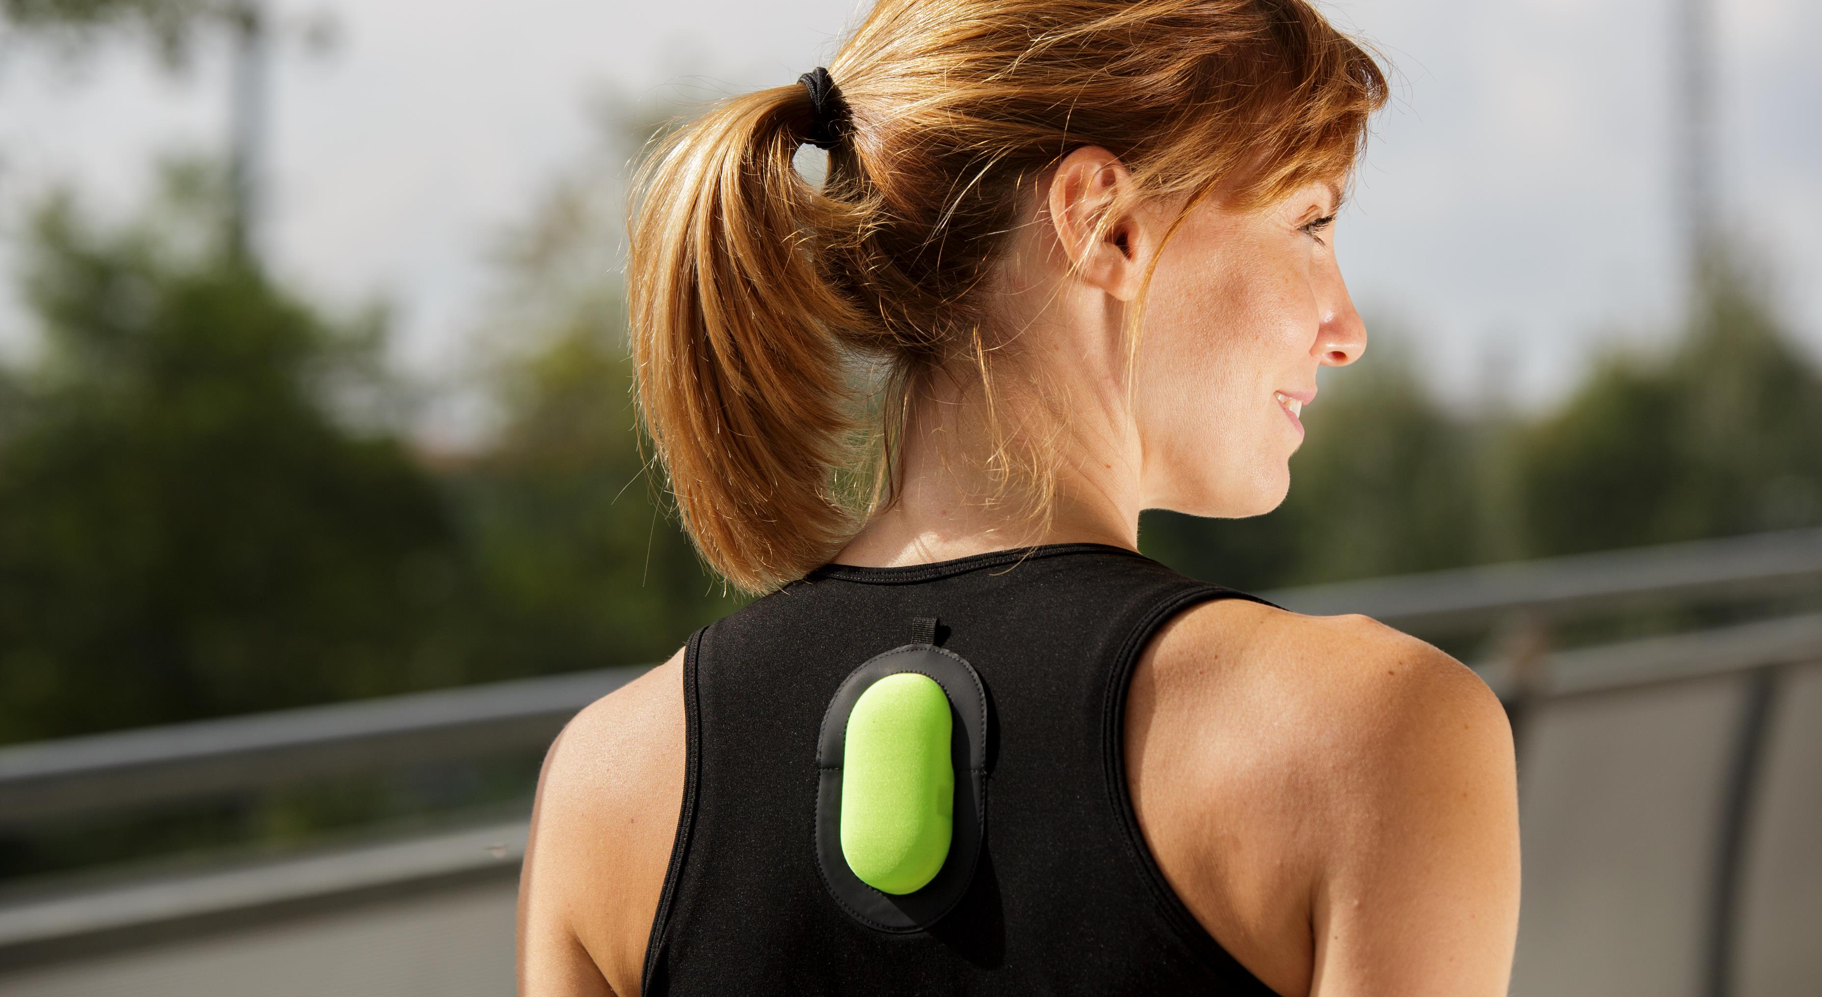
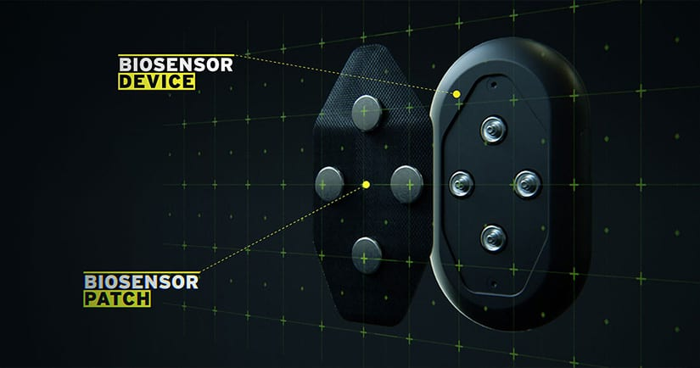



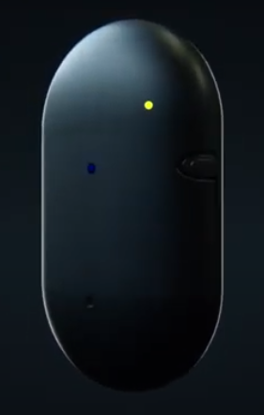


SweMax by Biometrica
Performance monitoring through dehydration control
by textile biosensors
for athletes
Dr. Nicola Coppedè PhD Physics Technology Developer
EUROPEAN SMART TEXTILE ACCELERATOR

Slide 2
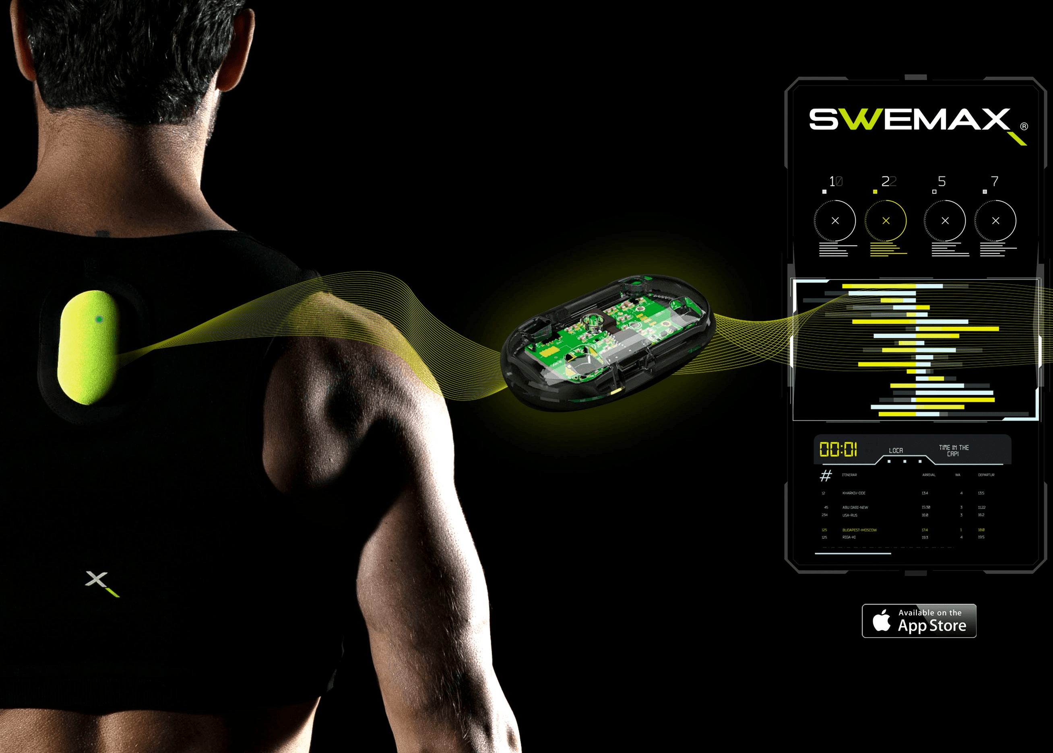
Solution
EUROPEAN SMART TEXTILE ACCELERATOR
Problem
Exhaustion due to
dehydration and mineral salts loss,
during training and in competition.
This leads to:
Mental confusion
Stress
Cramps
Fatigue
Blackout
Monitor in real time dehydration
and mineral salt levels
in sweat
during action

Slide 3
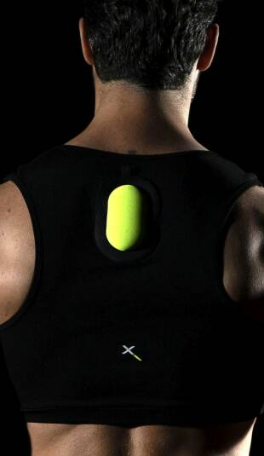
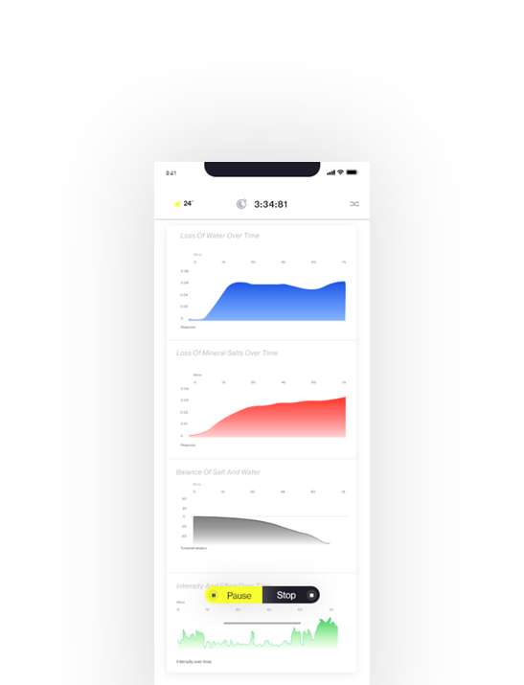
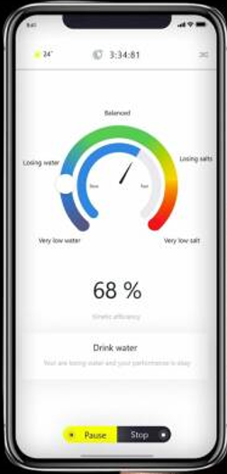

SmartX Project
EUROPEAN SMART TEXTILE ACCELERATOR
15 months of intense IMPROVEMENTS –
ready to Market
- final development of the BIOSENSOR smart patch
- professional electronics and casing 30% smaller
- a brand new dedicated technical t-shirt
- local & cloud data, and real-time app information
- IP & brandname analysis & re-positioning
- clearly identified market potential & Pre-sale launch
- Professional marketing campaign for crowdfunding
….. many, many meetings and R&D iterations !
….. now ready to sell a finished product to the market !
www.swemax.com

Slide 4
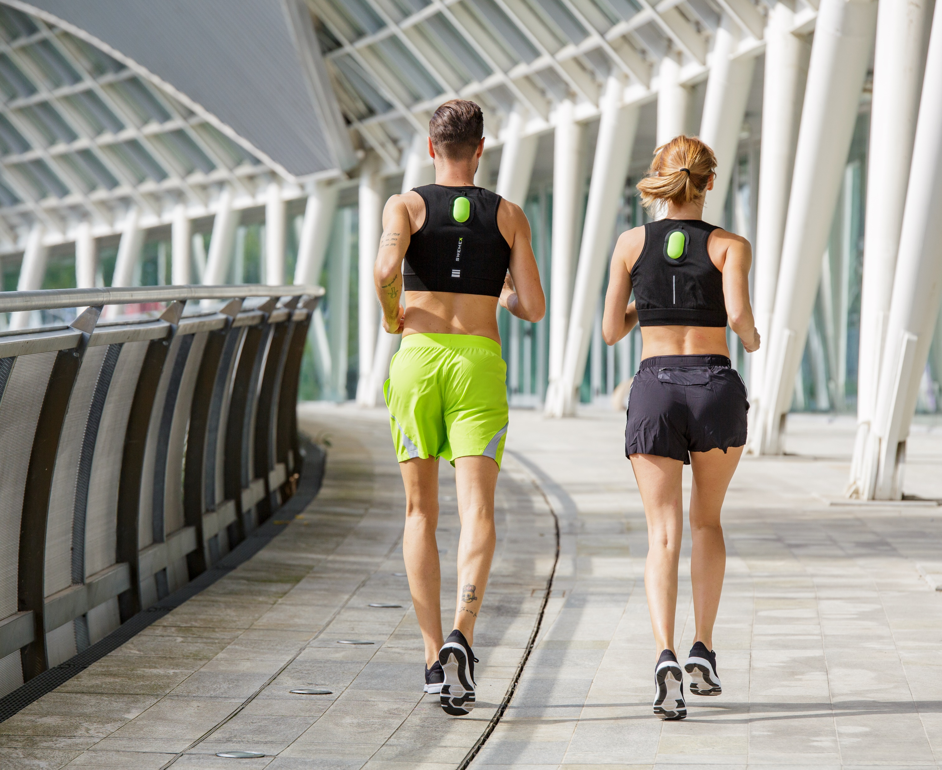

EUROPEAN SMART TEXTILE ACCELERATOR
https://www.swemax.com/
Boost Athletic Performance
Real-time monitoring of body sweat,
predictive analysis, injury prevention,
progress tracking
Thank You!
Dr. Matteo Beccatelli - Biometrica
m.beccatelli@biometrica.tech
Klaas Vande Velde – Worldklaas BV
kvandevelde@worldklaas.com
EUROPEAN SMART TEXTILE ACCELERATOR

