Slide 1

Bonjour.
Matthieu DELOBELLE
Ingenieur Electronique,
Projet E-POT

Slide 2



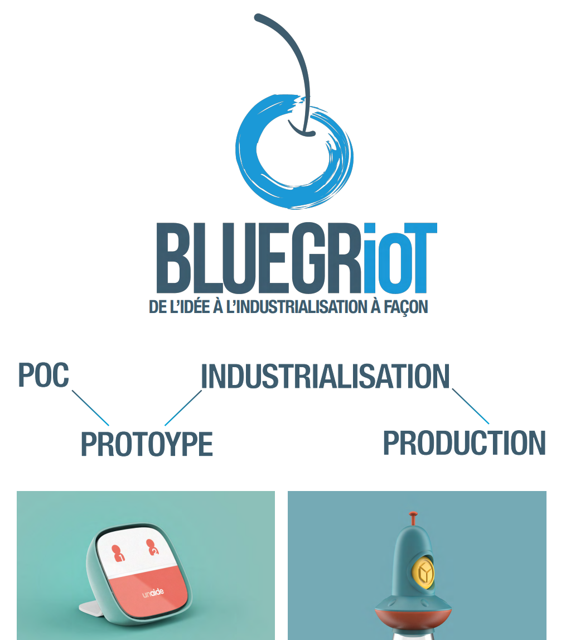


Slide 3







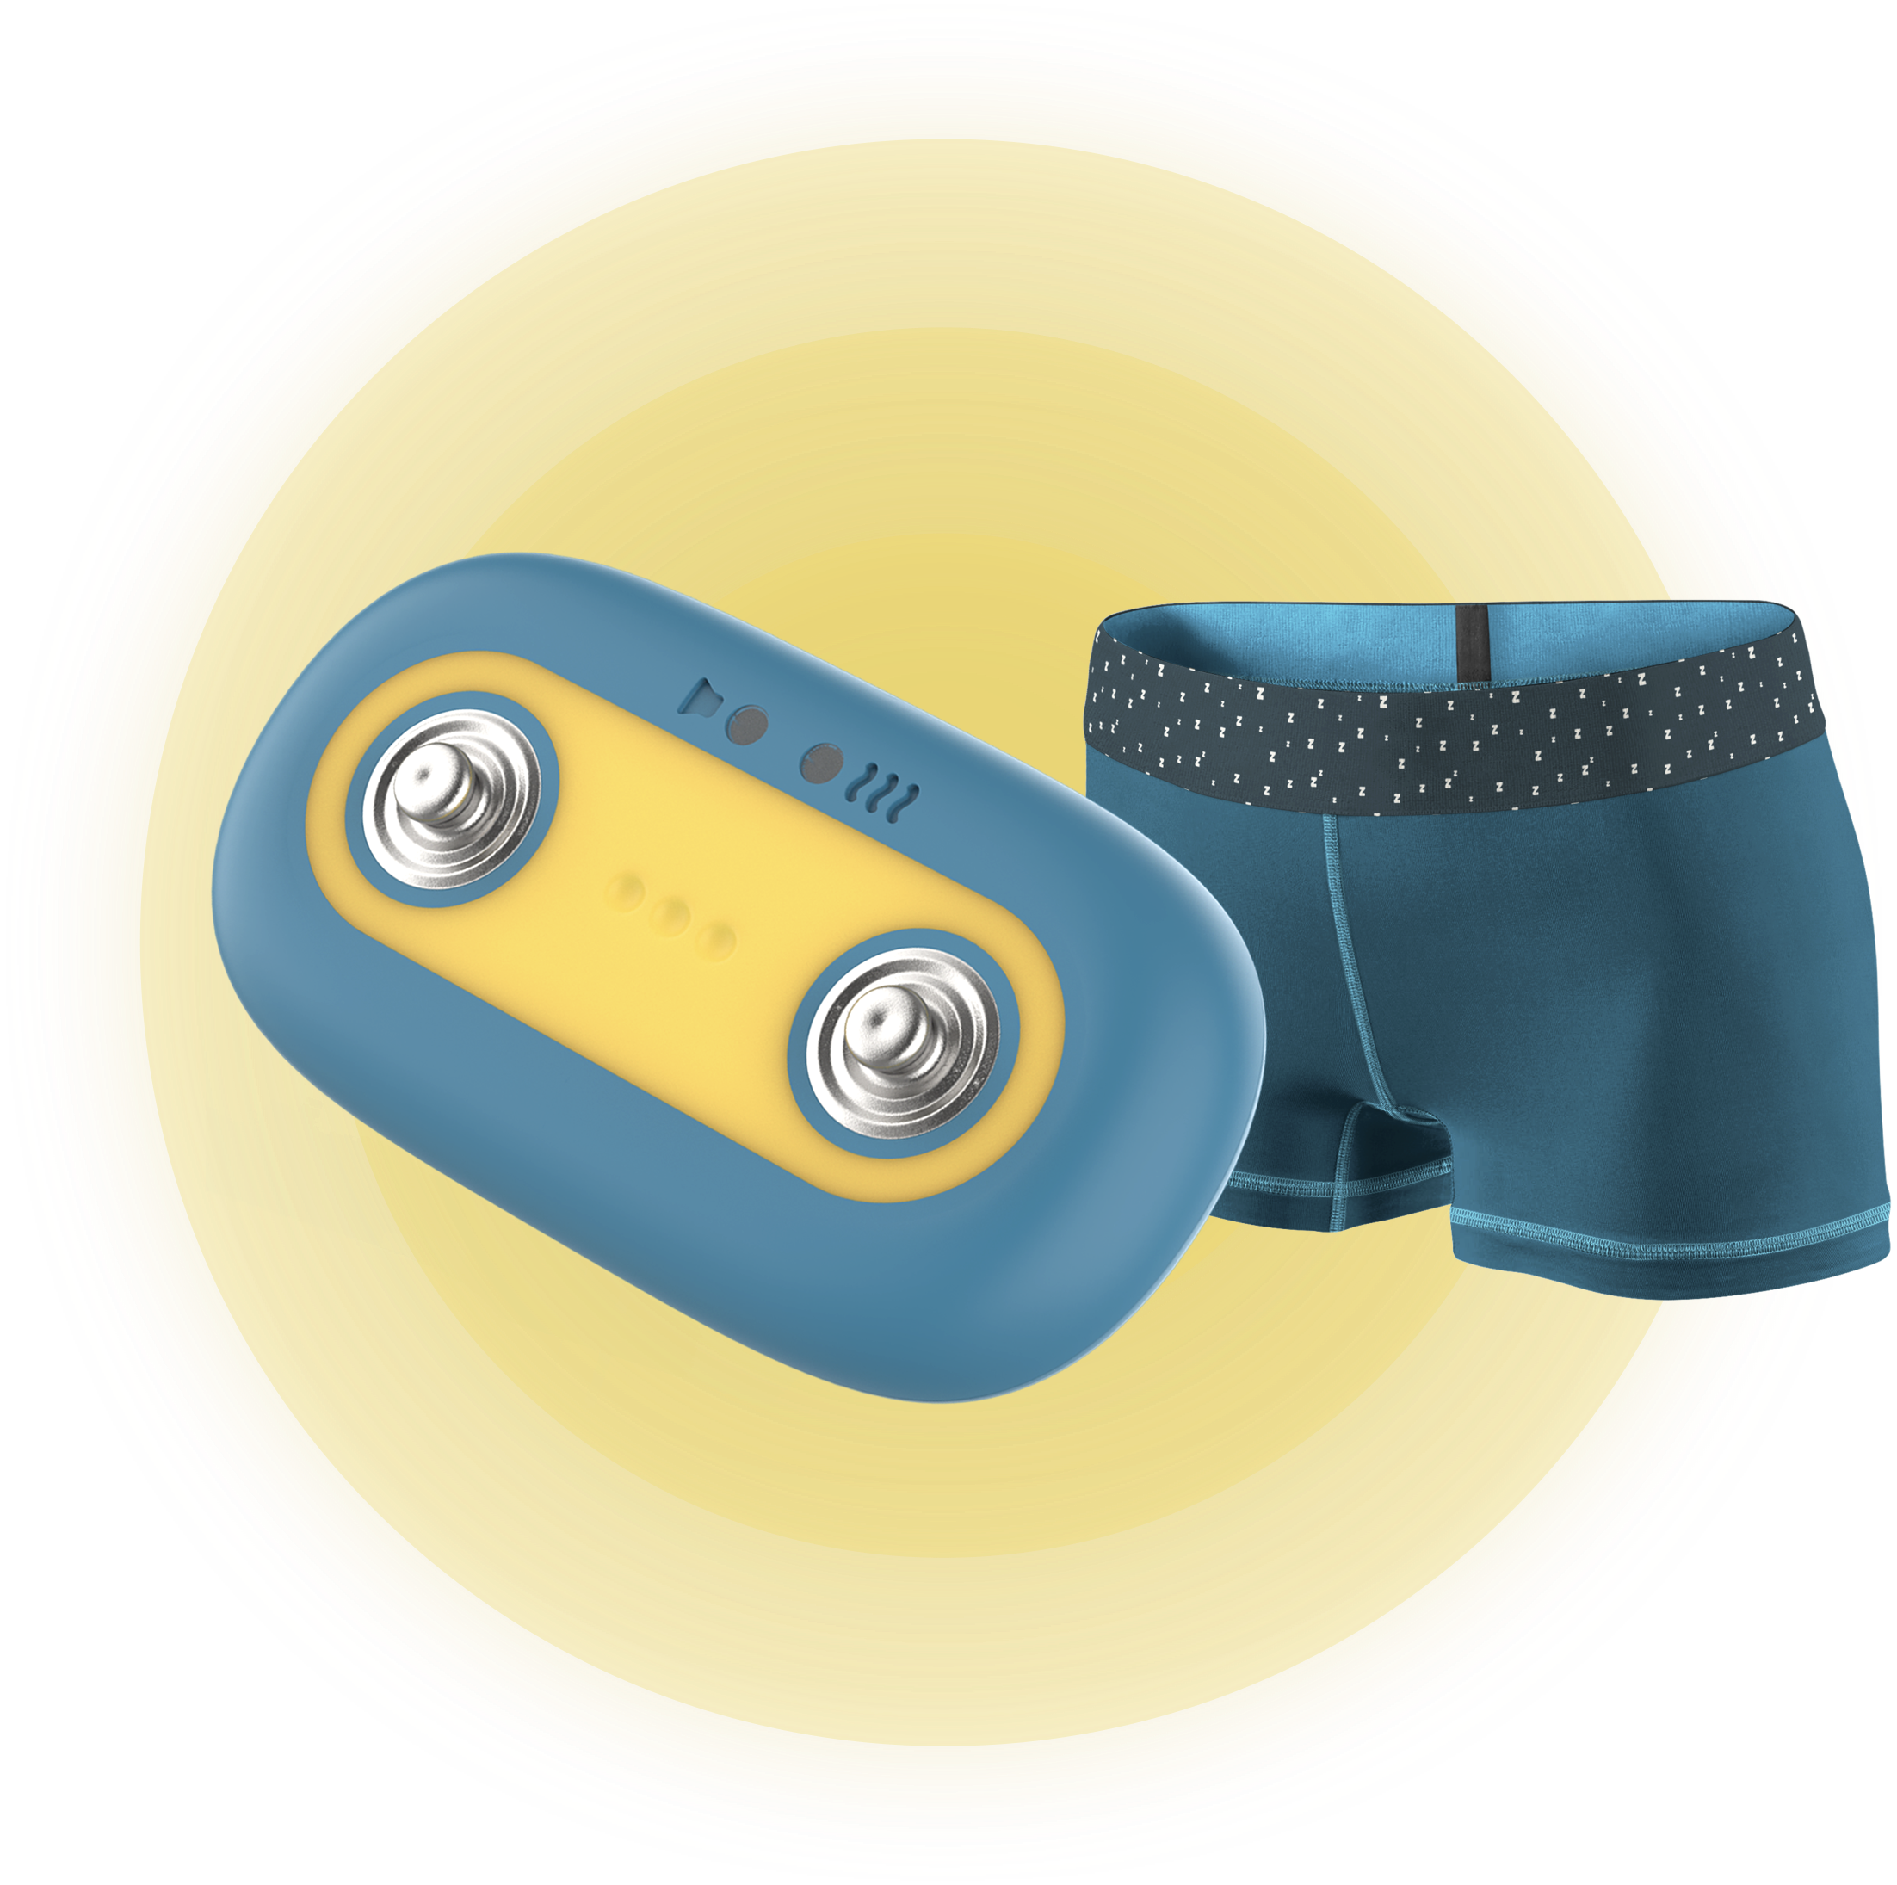








Designed with pediatrician
Invisible
E-POT
15%
BED WETTING
Technical fabric
Comfortable
ENURESIA
Discreet
No waves

Slide 4



E-pot Consortium

Slide 5


Slide 6
