Slide 1



Technical meeting – 21 April 2021

Slide 2

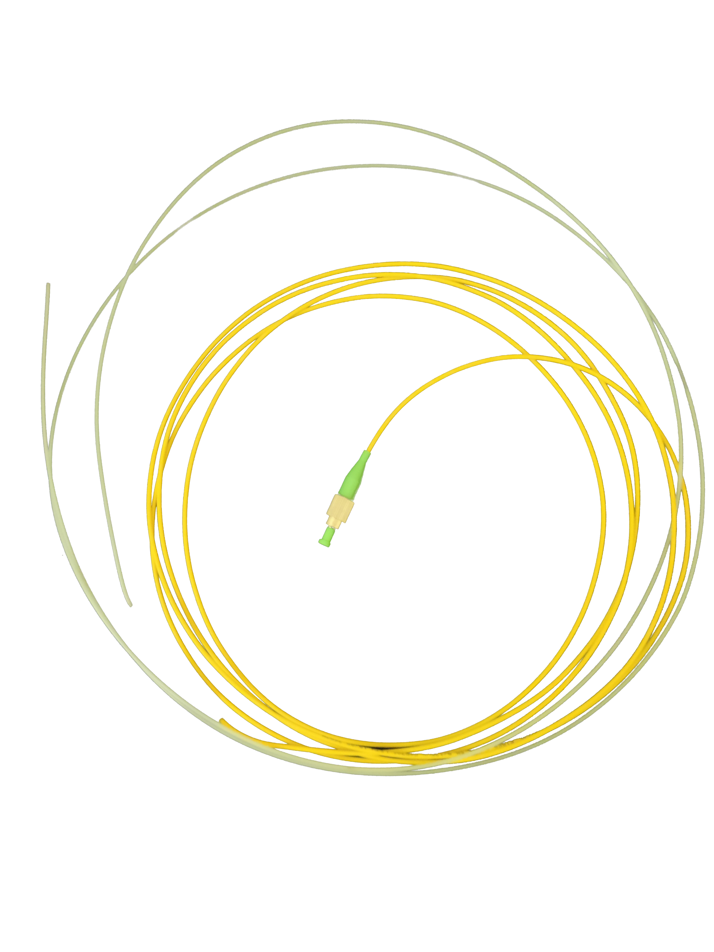
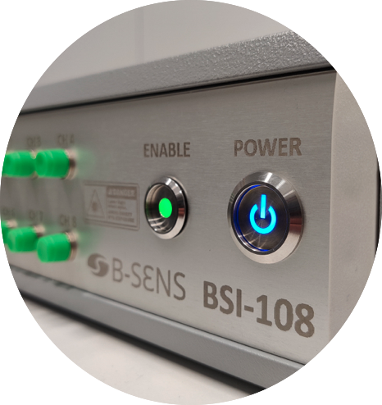
B-SENS in a nutshell
Spin-off from the University of Mons, launched in June 2016 (now 6 FTEs)
R&D company + B2B approach
Supplier of OEM sensors & sensing solutions based on optical fiber gratings
Development of multiplexed sensors or smart devices (IoT)
Original products + adaptation to customer’ specifications
For use in
  Temperature sensing & early fire detection
  Structural (health) monitoring & condition monitoring
  Environmental sensing
  And many more applications!

Slide 3
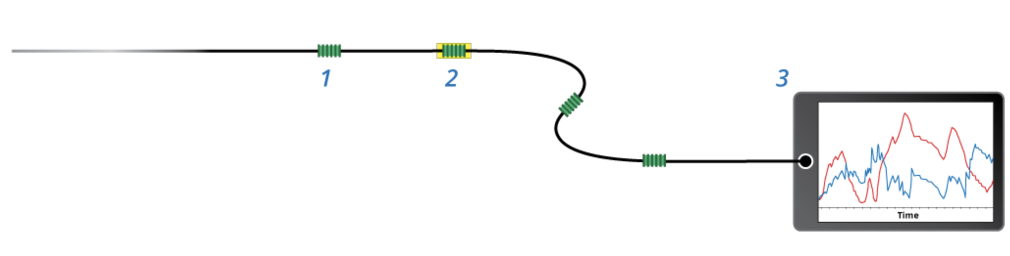
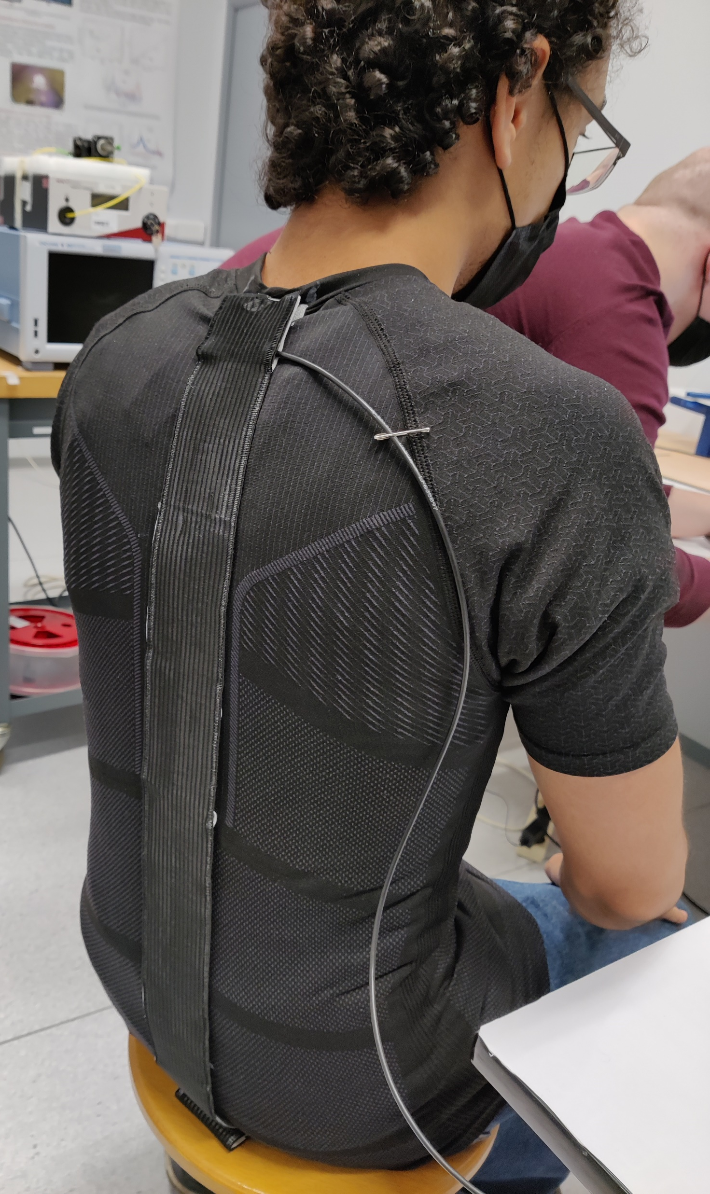
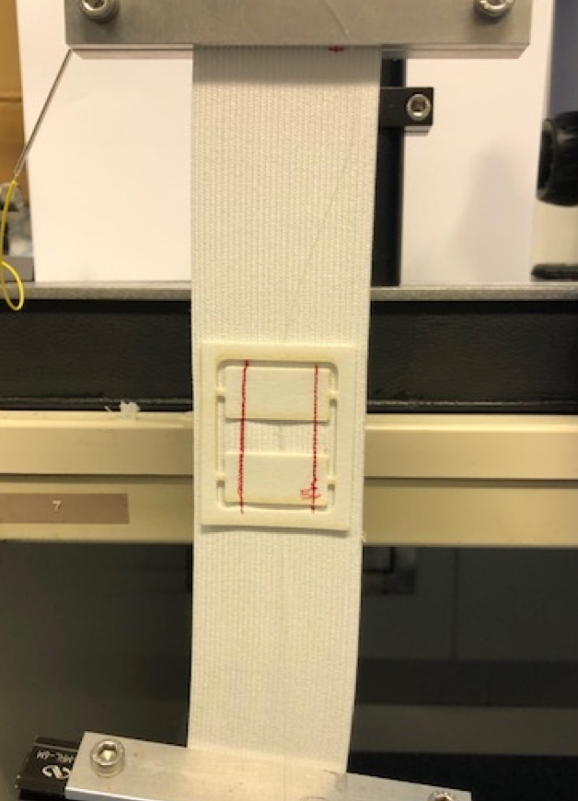
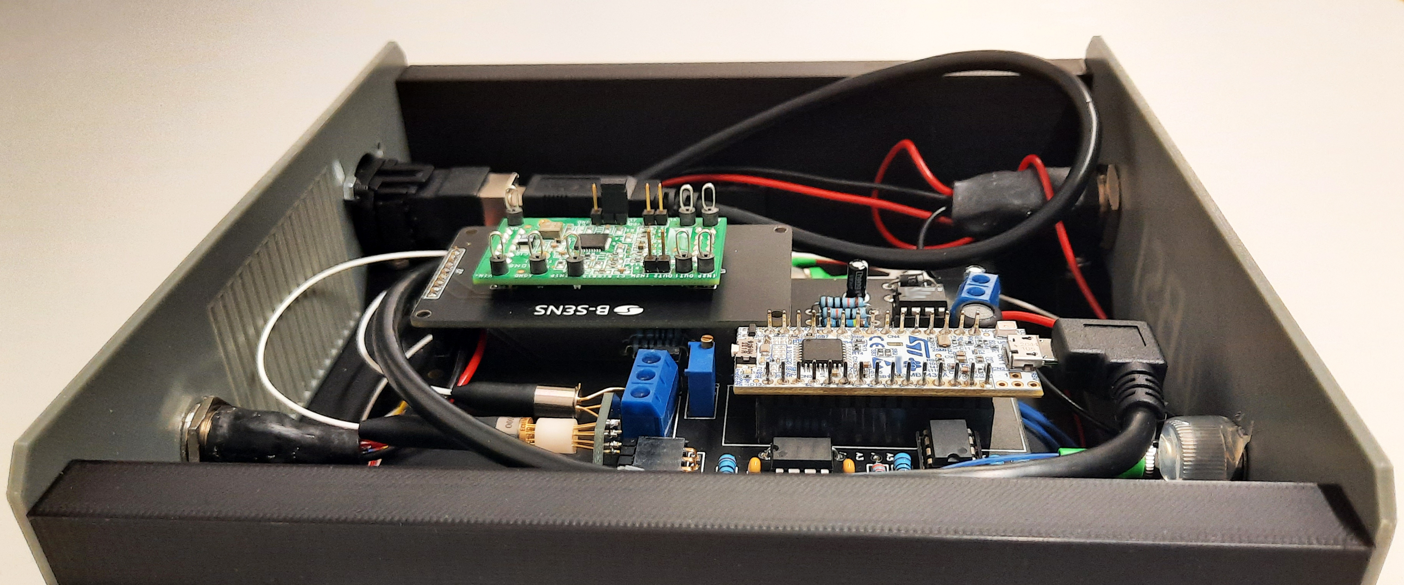
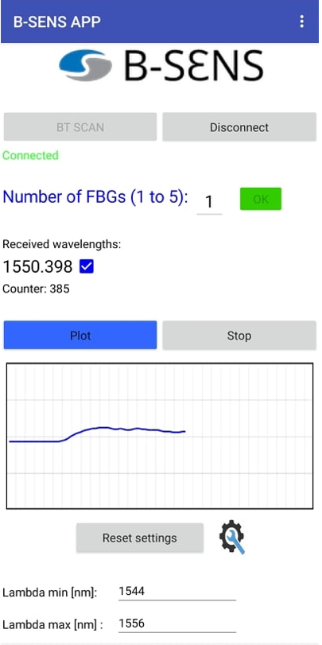
SAMBASOFT project
Smart and Ambulatory Monitoring of the Backbone using
Advanced Sensors based on the Optical Fiber Technology
Medical/Sport/Protection: point-of-care device to dynamically monitor the backbone position, especially for low back pain
Use of 4 sensors on a single fiber connected to an integrated read-out technique
Sensors integrated in a narrow textile for robust positioning over the backbone
Device integration into a small box that can be anchored on the belt
User-friendly interface for easy interpretation
Optical fiber connection
Bluetooth connection

Slide 4
Needs and challenges
Roadmap that will be followed towards product commercialization:
Q1 2022 End of device integration (battery-operated system for one-day autonomy and Bluetooth communication to a smartphone/tablet) and training/testing on up to 10 people
Q1 2022 Start prospection with identified industrials from ELASTA’s customers
Q2 2022 Clinical study at CHU Lille (Dr. Tiffreau) and training/testing on up to 50 patients
Q3 2022 Initiate CE Medical Device compliance process
Q4 2022 Participation to MEDICA
First sales anticipated by Q3 2023

